Slide 1
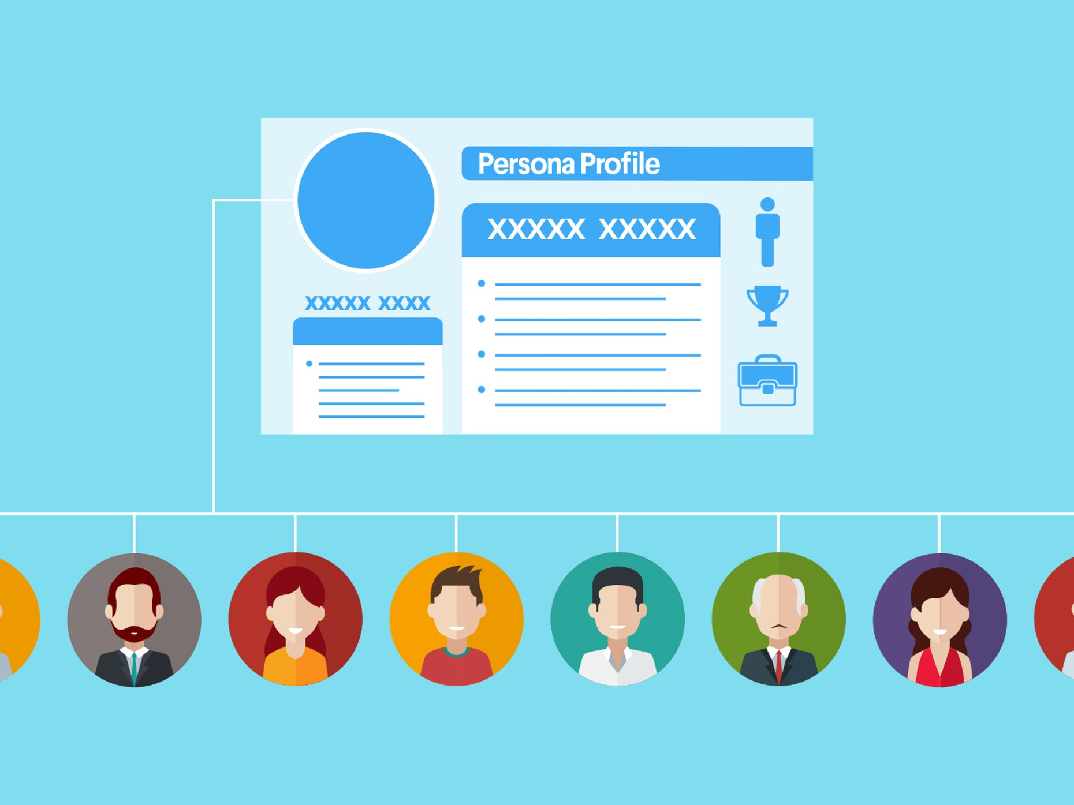
PERSONAS
A personas is a profile. A character sketch A user persona is a representation of the type of user
who will benefit most from your product It isn’t something you build based on guesses and it isn’t fictional.
A user persona is based on research and qualitative and quantitative data
collected through user interviews and surveys.

Slide 2
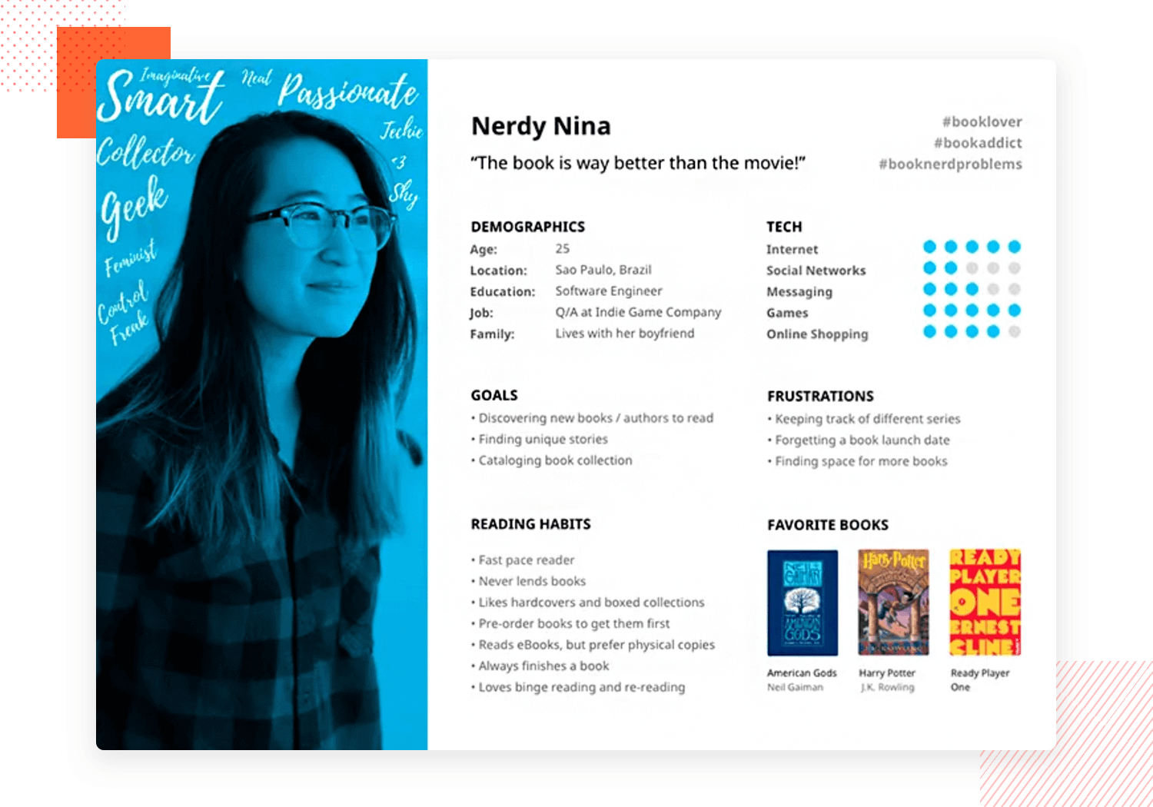
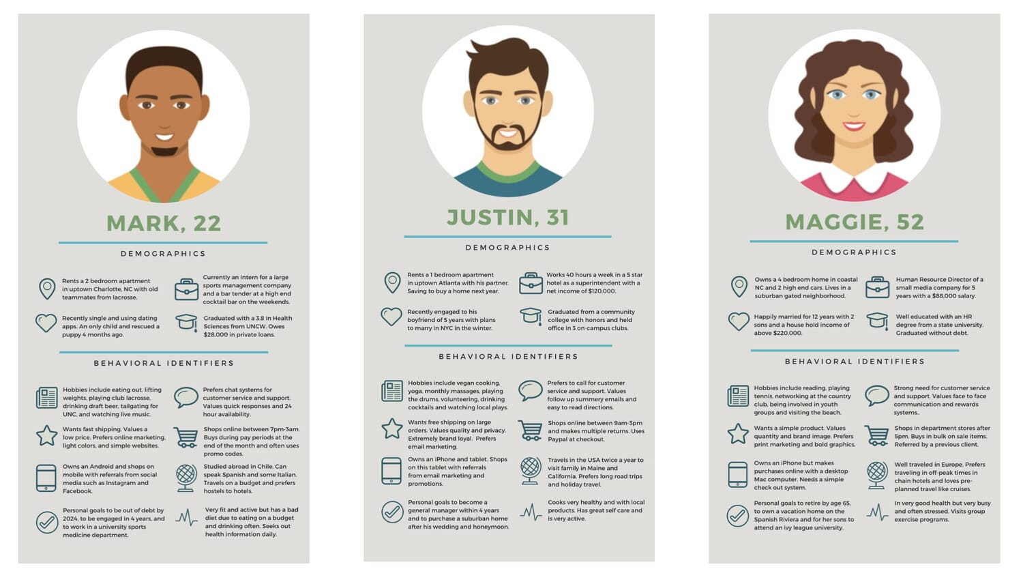
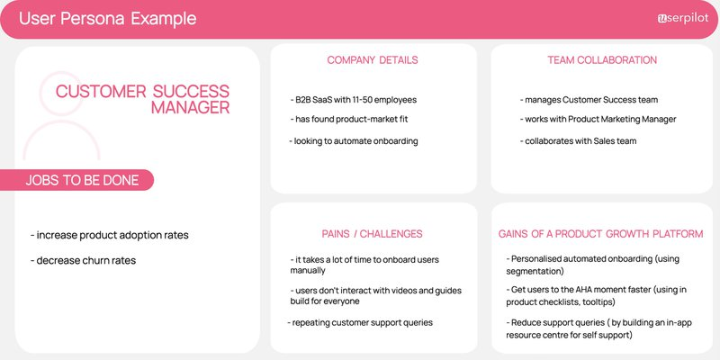
EXAMPLE OF PERSONAS

